Slide 1
ETHICAL HACKING INTERNSHIP Task 2
By – Aashutosh Sharma

Slide 2

Objective
To Find three vulnerabilities in a site http://zero.webappsecurity.com/ and prepare a report on a vulnerability
Tool Used- intruder.io
Tool logo-

Slide 3
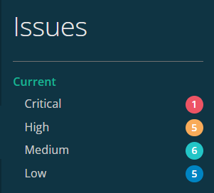
Vulnerability Issues Found in The Site

Slide 4
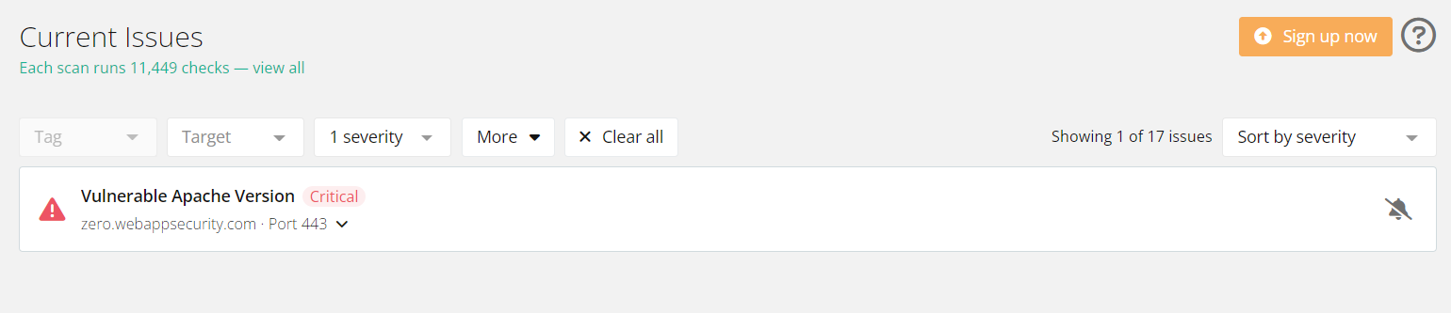
Critical Vulnerabilities

Slide 5
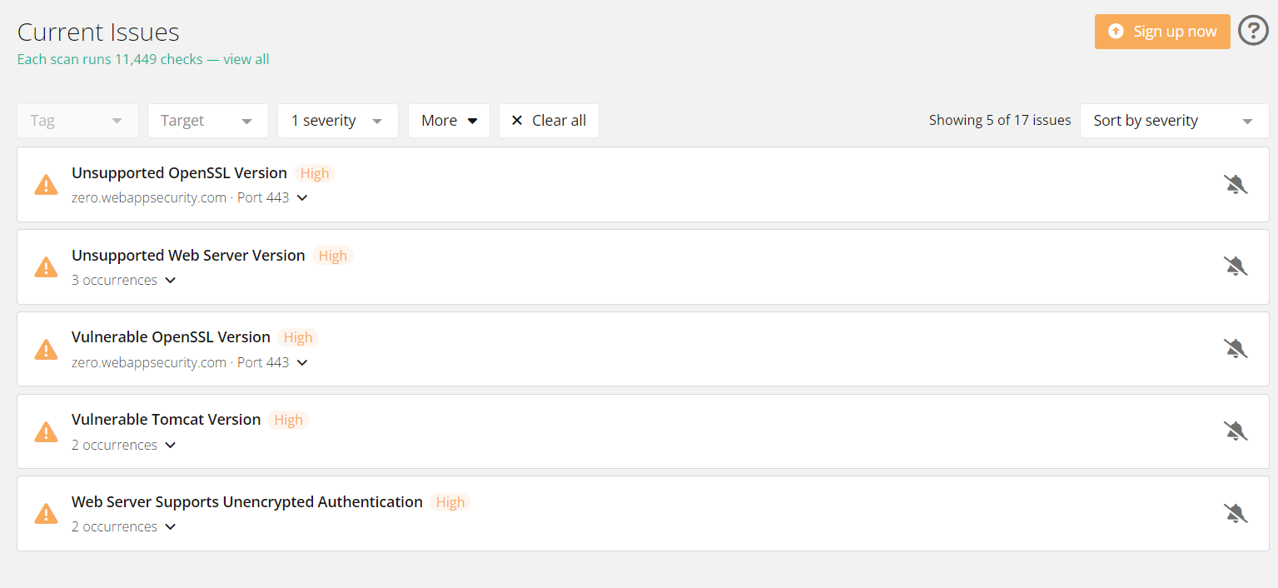
High Vulnerabilities

Slide 6
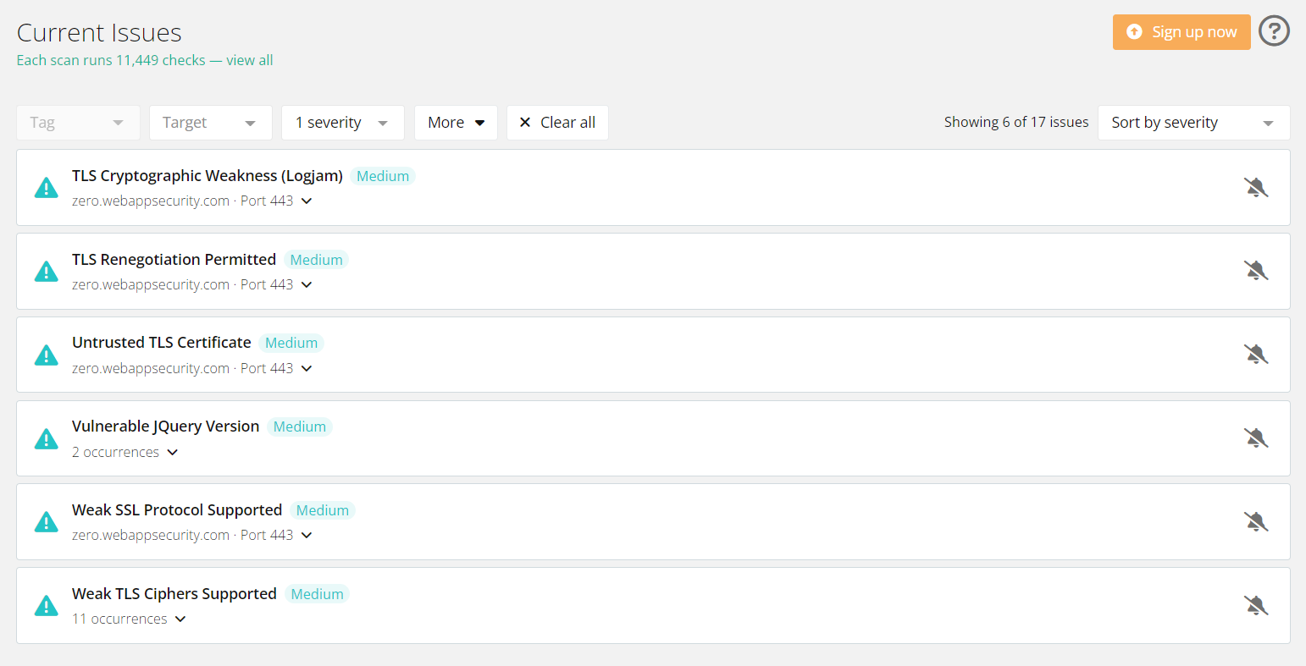
Medium Vulnerabilities

Slide 7
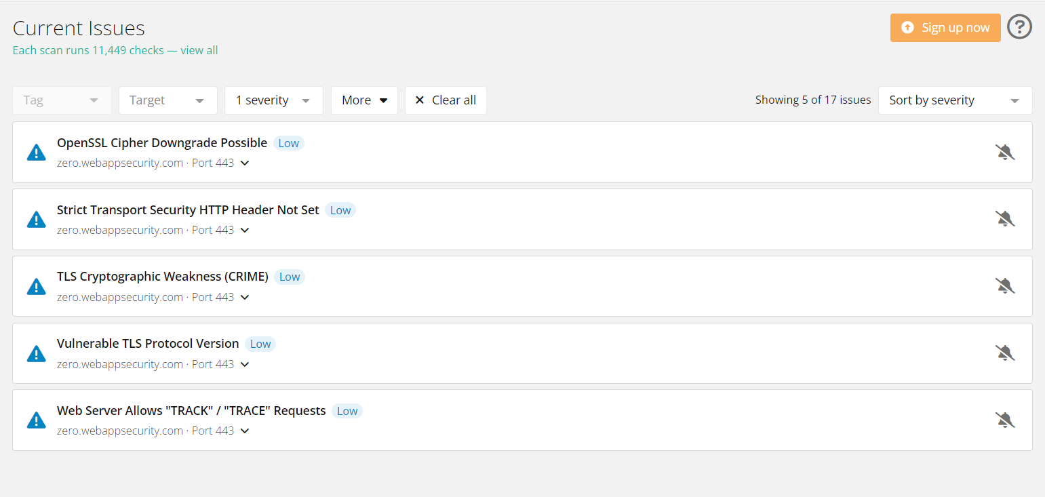
Low Vulnerabilities

Slide 8
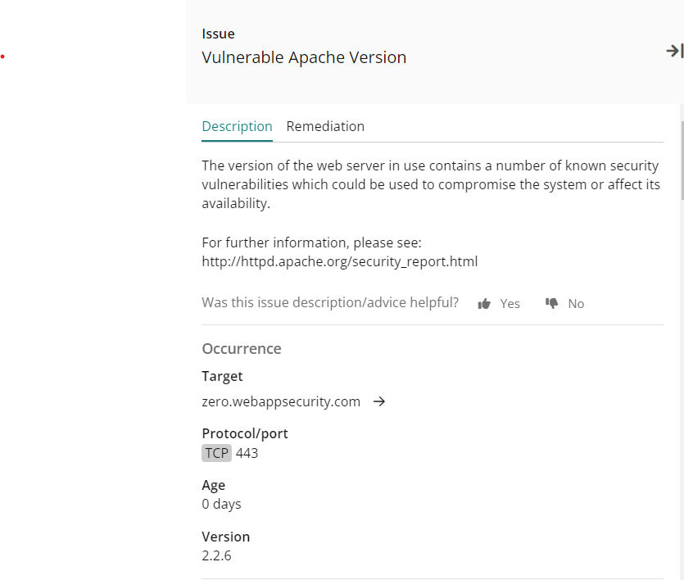
Generated Report on Critical Vulnerability

Slide 9
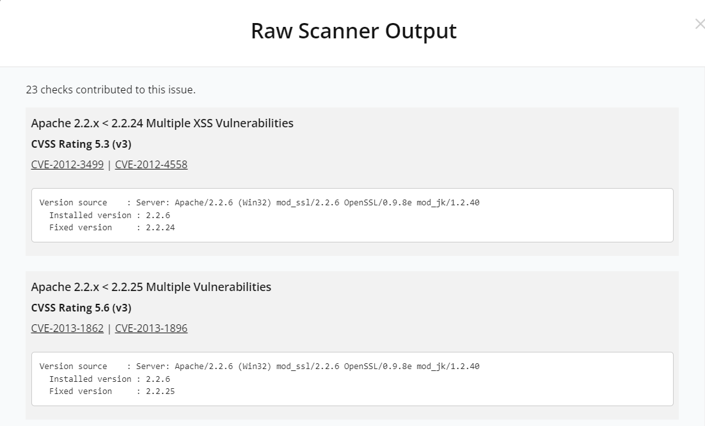
Raw Scanner Outputs of Critical Vulnerability

Slide 10
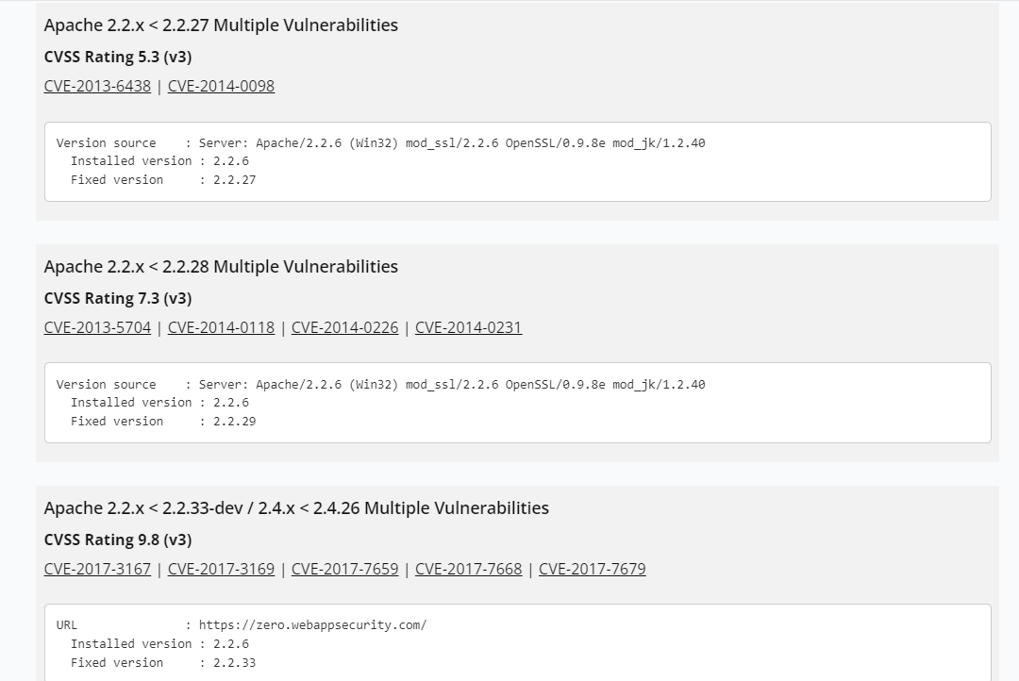

Slide 11
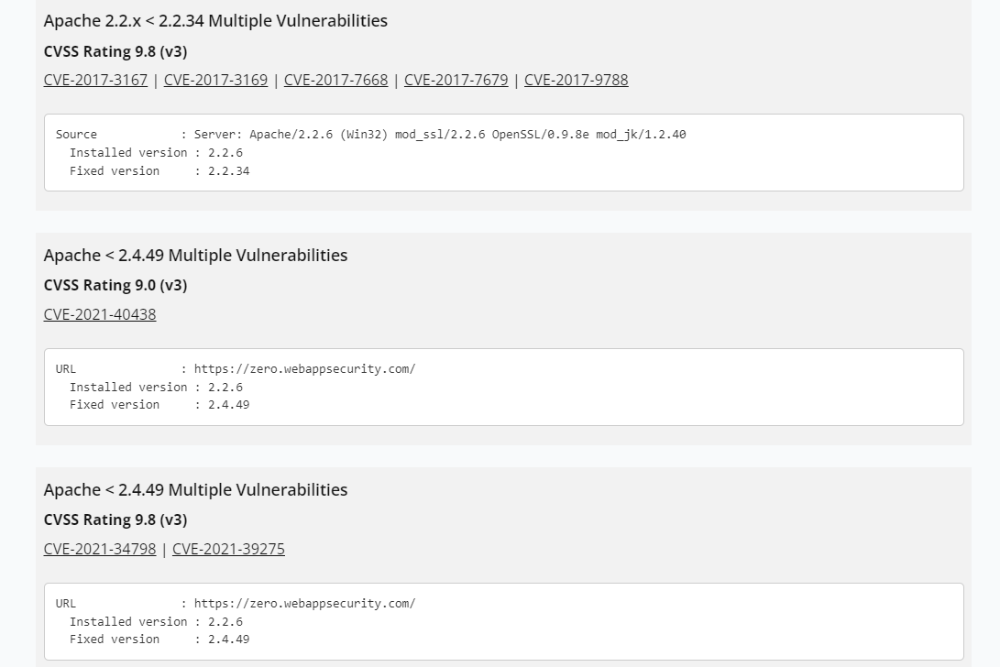

Slide 12
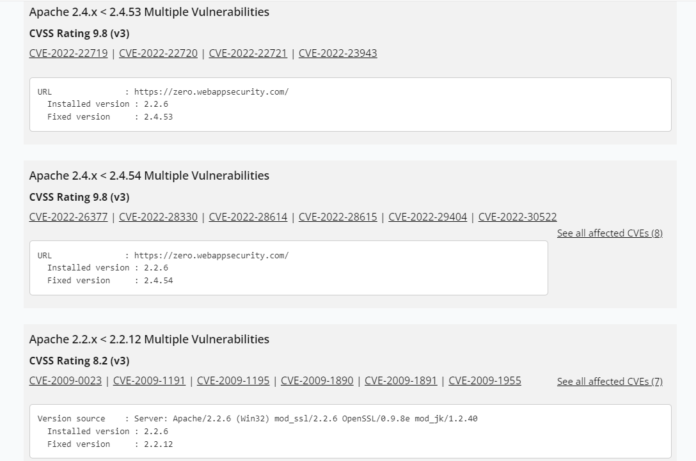

Slide 13
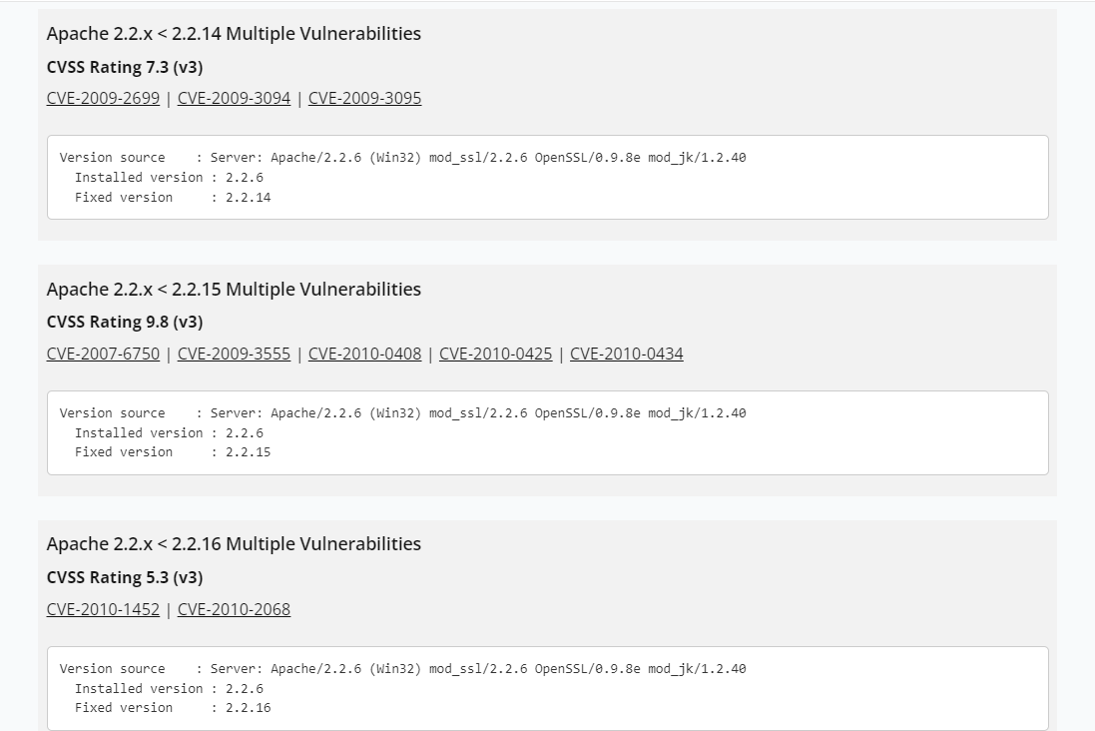

Slide 14
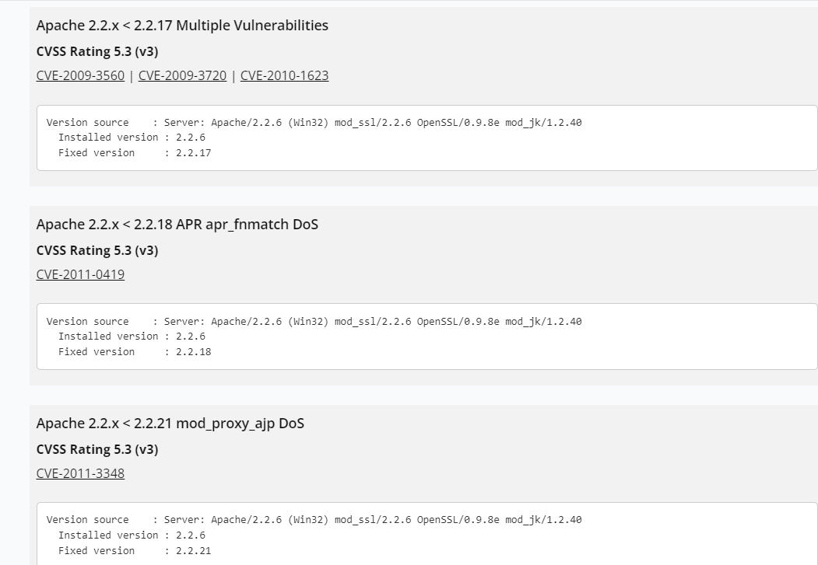

Slide 15
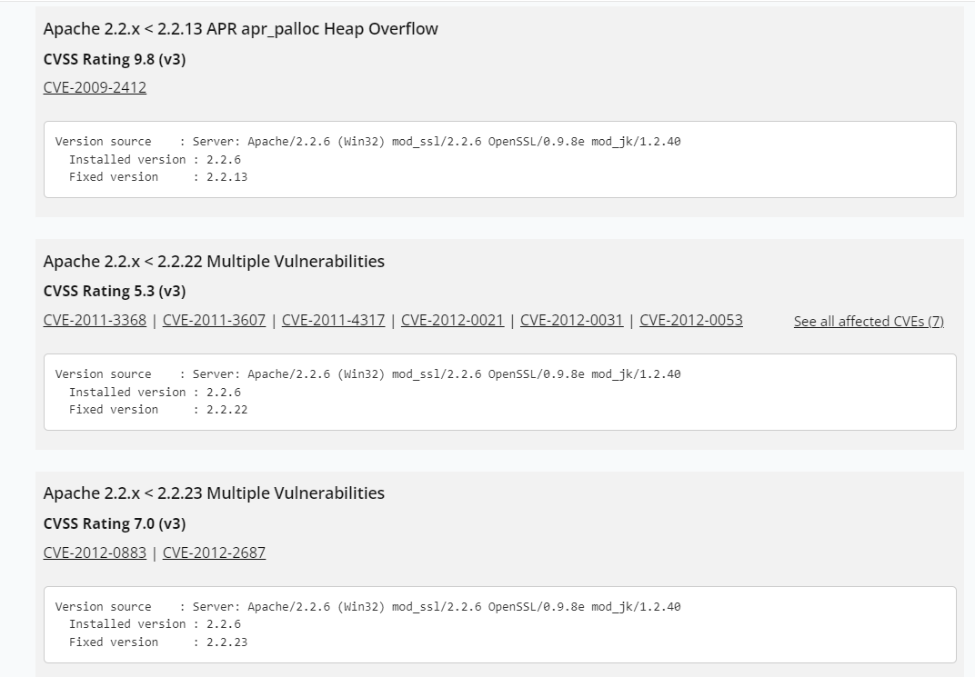

Slide 16
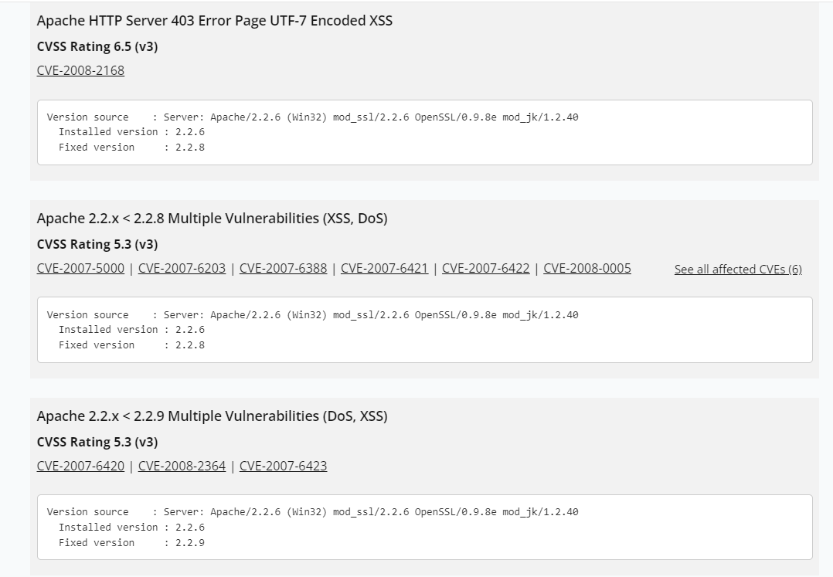

Slide 17
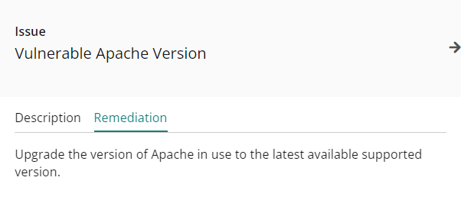
Solution Proposed By Tool

Slide 18
My Report
Site scanned - http://zero.webappsecurity.com/
Tool Used – intruder.io
About Tool – Intruder.io is an automatic vulnerability analysis tool similar to Netsparker which is used to scan various sites for vulnerabilities and give a detailed report of all the vulnerabilities present in the site. It classifies the vulnerabilities into 4 categories namely critical, high, medium and low. It is a paid tool used by various organizations and allows 30 days trial period before purchase.

Slide 19
My Observations after Scan
The tool reported 17 vulnerabilities in the scanned site out of which 1 was critical , 5 were high, 6 were Medium and 5 were low. I have analysed the critical Vulnerability which was present on the site.
Name of vulnerability – Vulnerable Apache version
Description – The Apache version of the site was found to be 2.2.6 which is a very older version and this vulnerability can give way to various vulnerabilities like cross site scripting, sql injection, DOS etc.
Mitigation – The admin of this website need to update this Apache version to the latest available version in order to protect the website from several vulnerabilities.

Slide 20


